Slide 1
HUMAN COMPUTER INTERACTION PROJECT
PROJECT TITLE : INTERACTIVE TASK MANAGER
DONE BY :
YASHAS B PRASAD - PES1201800323 - 6TH SEM A SECTION
SANTOSH BISHNOI - PES1201801998 - 6TH SEM H SECTION
PHILIP JOSEPH - PES1201801444 - 6TH SEM A SECTION
B BHUVANESH - PES1201801759 - 6TH SEM D SECTION

Slide 2
PROBLEM STATEMENT
To develop an interactive task manager that can store and remind users everyday tasks in an easy and interactive way which is easy to use and easy to manage.

Slide 3
NEED FINDING
Users can use this to store task for the day
Can be used by users to store future events
Can be used by users to view tasks according to priority
Users can use this web app to view upcoming events sorted date wise
Tasks can be added and removed as and when tasks gets added or gets completed

Slide 4
FUNCTIONS IMPLEMENTED & USE CASE OF THE PROJECT
New tasks can be added.
Tasks added can be given a priority
Date and time can be added to the task which acts as a deadline
The added tasks can be edited later for any new changes
Once the task is completed users can remove the task by a single click.
There is also a clear all functions clears the entire list once all the tasks are completed
While adding the tasks , users can see a monthly view of the calender with the days of the week and also the present date highlighted
There is a 24 hour clock function that can be used by the users to select the deadline for the time

Slide 5
DESIGN APPROACH
Since the project was to be made designed to illustrate human computer interaction we have used HTML , CSS & JS to create a GUI experience for the user.
Adding new task is very simple since another HTML page takes care of adding the task. There is no lag in between the change of page.
While adding new events to the task manager, users has to input the date and time for the deadline. Choosing the date and time is also a very seamless experience.
Once a new task is added it can be edited or removed by a click of a button and the experience is also very seamless
Once all the task have been added, it automatically sorts them according to the date and displays them in the sorted order to the users
All the tasks can be removed by a single click with a prompt message confirming the deletion of all the task. This is done so that users don't accidentally delete the task

Slide 6
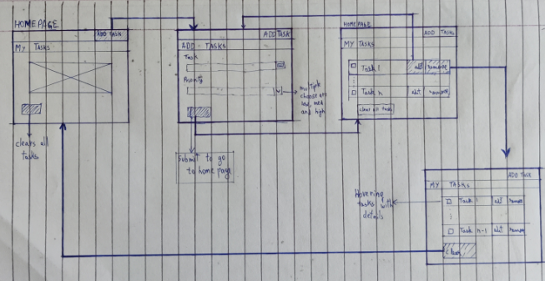
LOW FIDELITY PROTOTYPE

Slide 7
PROJECT DEMO

Slide 8
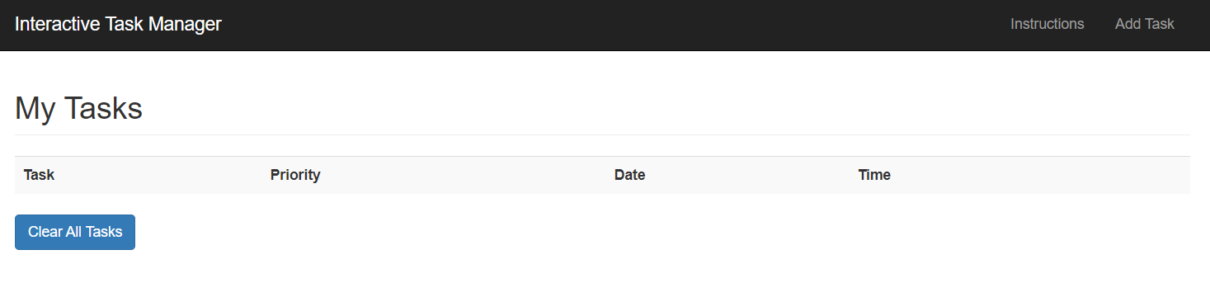
HOME SCREEN

Slide 9
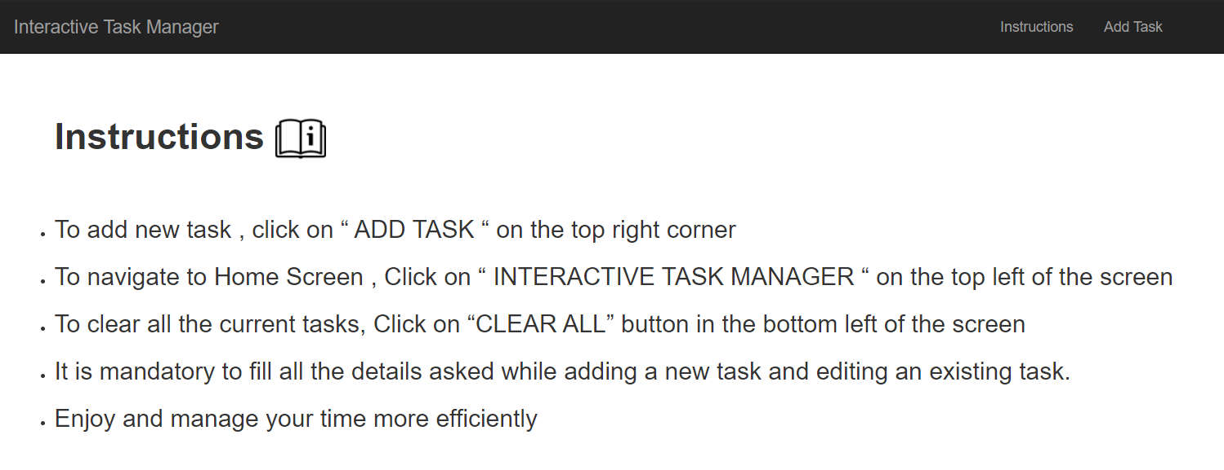
INSTRUCTIONS

Slide 10
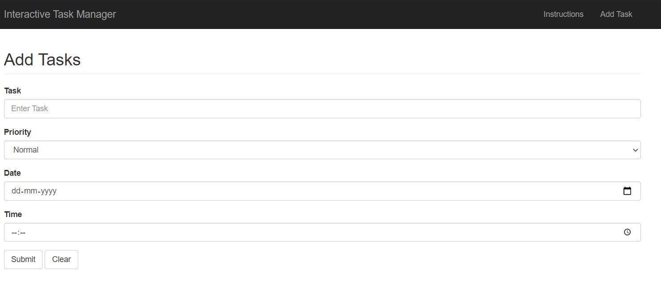
ADD TASK SCREEN

Slide 11
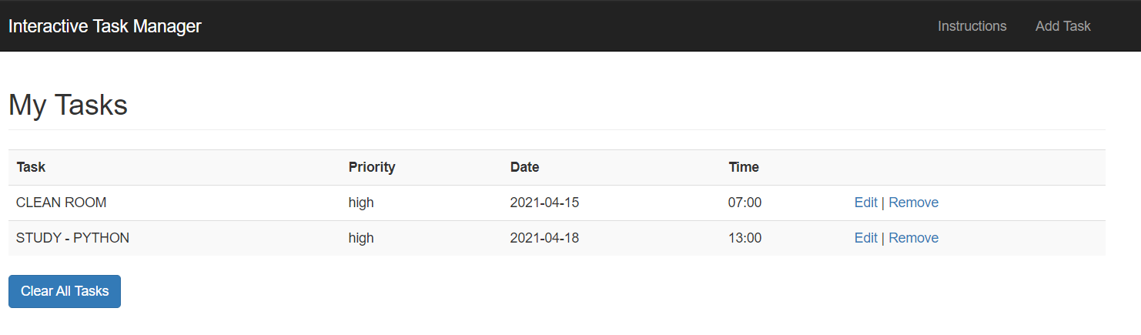
HOME SCREEN WITH ADDED TASKS

Slide 12
HEURISTIC EVALUATION
1. Visibility of system state
The heading of the page clearly informs user the page he is in and describes the page. Ex. Add task, My tasks.
2. Match between system and real world
The system speaks the user language i.e, uses familiar words and phrases making the user more comfortable while using the platform
3. User control and freedom
Edit option given to the user to make changes to existing tasks.
All the input options are editable i.e, name, task, date, time
clear option available on the add task page so that user can clear the input entries at once

Slide 13
HEURISTIC EVALUATION
4.. Consistency and standard
The terminology used is in line with other digital products as to maintain external consistency and the user isn’t forced to learn something completely new which increases cognitive load on the user.
5.. Error prevention
While adding a task the user might assume that a particular input is not mandatory and could skip filling it, so the user is shown that the the particular entry is mandatory in form of a tooltip
6. Recognition rather than recall
During no point of the user’s journey he would be presented with opportunity to recall a functionality.

Slide 14
HEURISTIC EVALUATION
7. Flexibility and efficiency to use
For the recurring users we provide them with a shortcut to add a task using “Ctrl + T” on windows and “Cmd + T” on Mac. This makes it easier for the user when he wants to add a task on the fly.
8.. Aesthetic and minimalist design
No unnecessary elements that increases the cognitive load on the user are present on the page. The minimalist design lets the user perform the action of adding and viewing task seamlessly.
9. Help user recognize from error
The input form cannot be left empty. When a user tries to submit the form leaving one or more inputs empty and dialog box showing an error message appears.
If the input value for the date or time is incorrect a tooltip prompts with user with message to enter a valid input

